Slide 1
0414Meeting

Slide 2
數學小隊

Slide 3
Coding 小隊
1. Dataset: search or construct
2. Laplacian: realized by package/hand
3. Plan: parameter, the number of selected vectors

Slide 4
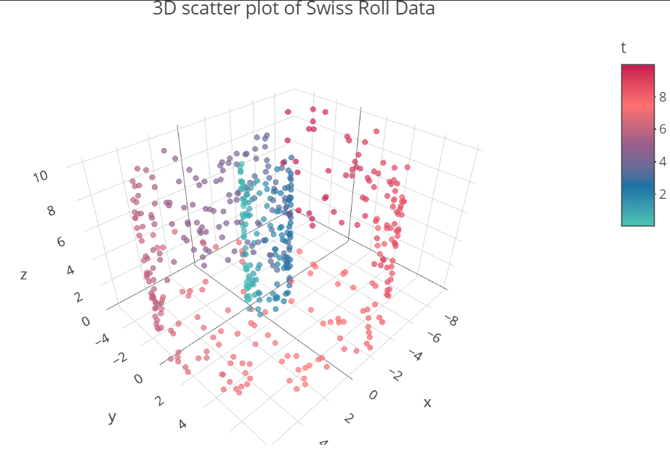
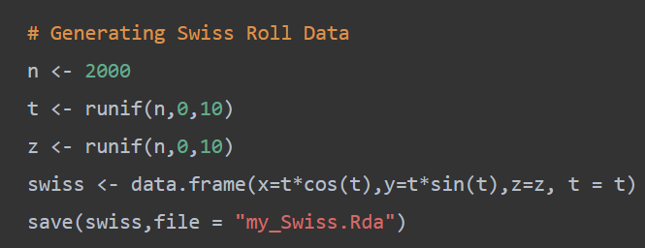
Dataset
p(number of columns): 4
column names: x, y, z, t
low dim manifold: F(t, z)=0
1. Swiss Roll / My Swiss

Slide 5

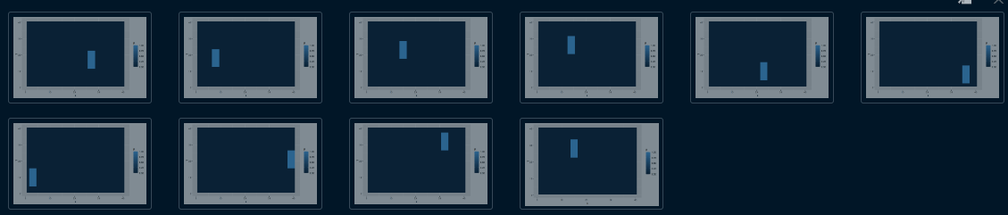
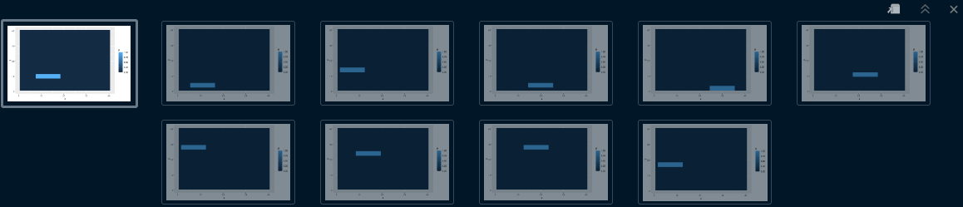
Dataset
p(number of columns): 1600
column names: v1,...,v1600
elements: 0/1
sum(x_i) is the same: width*length
1. Swiss Roll / My Swiss
2. Vertical/ Horizonal Bars
low dim manifold:
F(startx, starty;shape)=0
[0,...0,...0,...0
0,...1,...1,...0
...,...,...,...
0,...1,...,1...,0
0,...0,...0,...0]

Slide 6
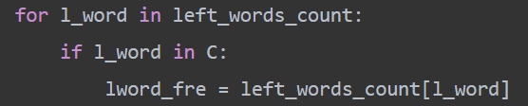
Dataset
p(number of columns): 600
column names: l1,...,l300,r1,...,r300
elements: integers{0,1,2,...}
context embedding
1. Swiss Roll / My Swiss
2. Vertical/ Horizonal Bars
3. Corpus
”window”: 2+1+2
Count the cooccurrence frequency
Example:
This book describes and [illustrates] a sunny day.

Slide 7
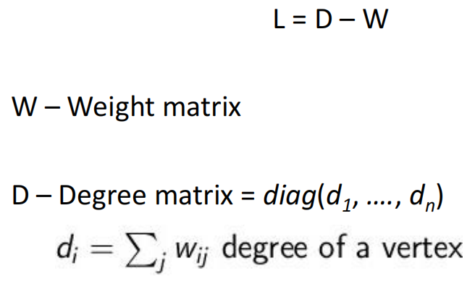
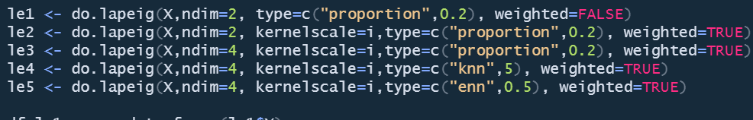
Laplacian
le1 <- do.lapeig(X,ndim=2, type=c("knn",k), weighted=FALSE)
Input: X(n*p) matrix or R data.frame
Method:
proportion
knn (k nearest neighbor)
enn (epsilon nearest neighbor)
Kernel: turn on or not
1. do.lapeig() function

Slide 8
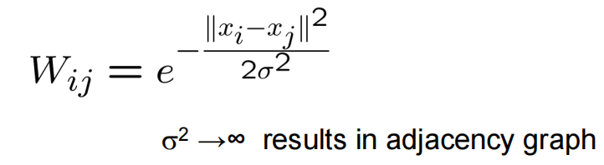
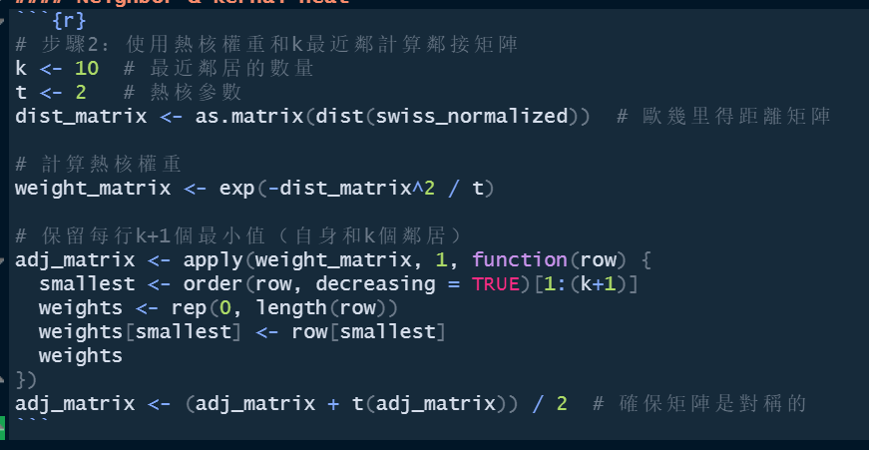
Laplacian
1. do.lapeig() function
2. made by hand

Slide 9
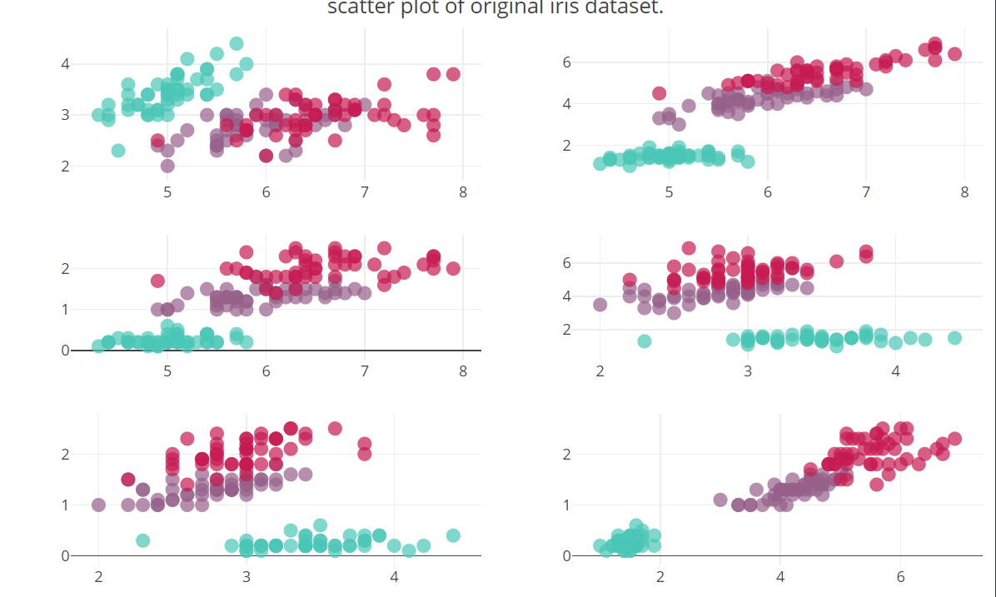
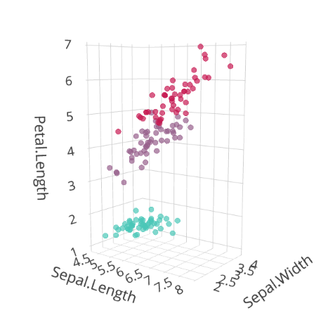
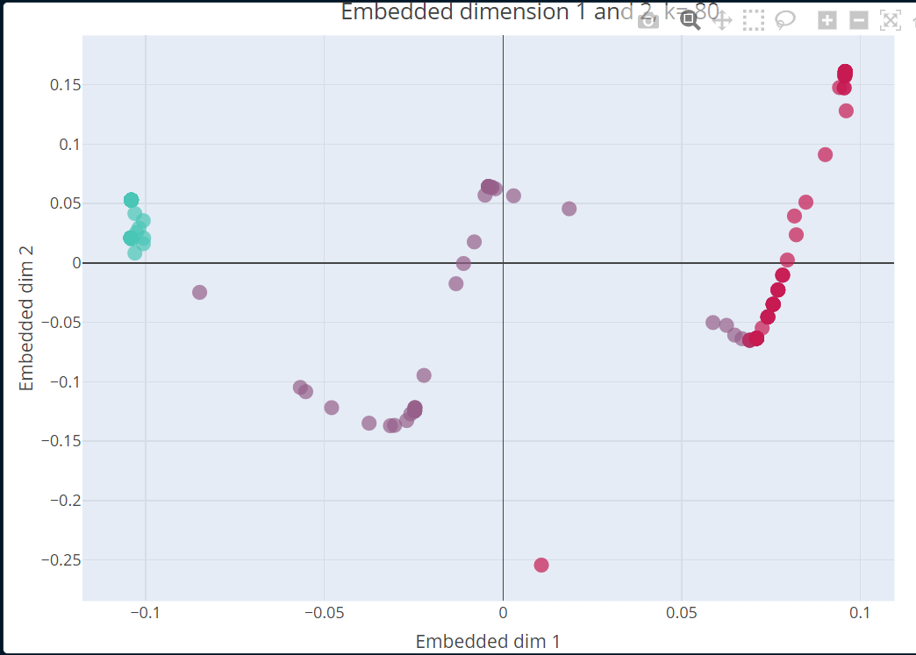
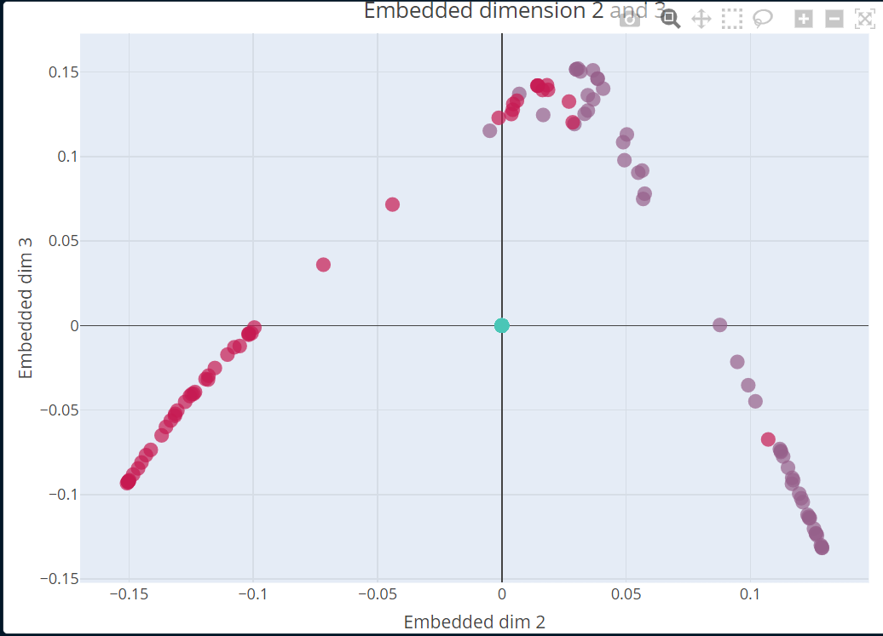
Toy Results

Slide 10
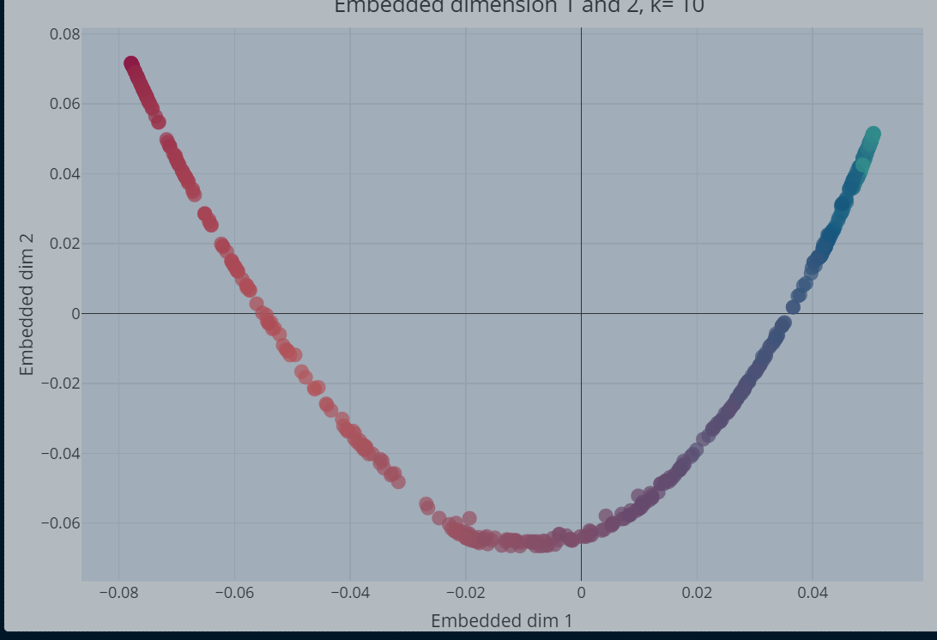
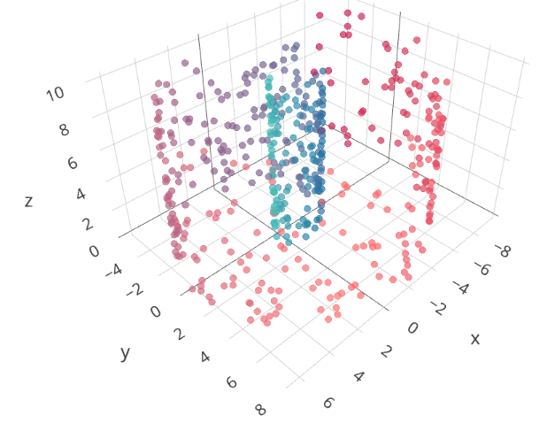
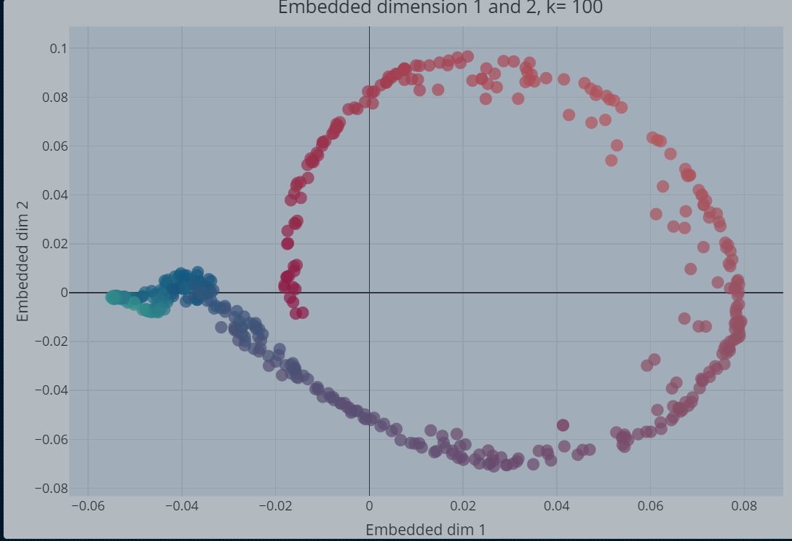
Toy Results

Slide 11
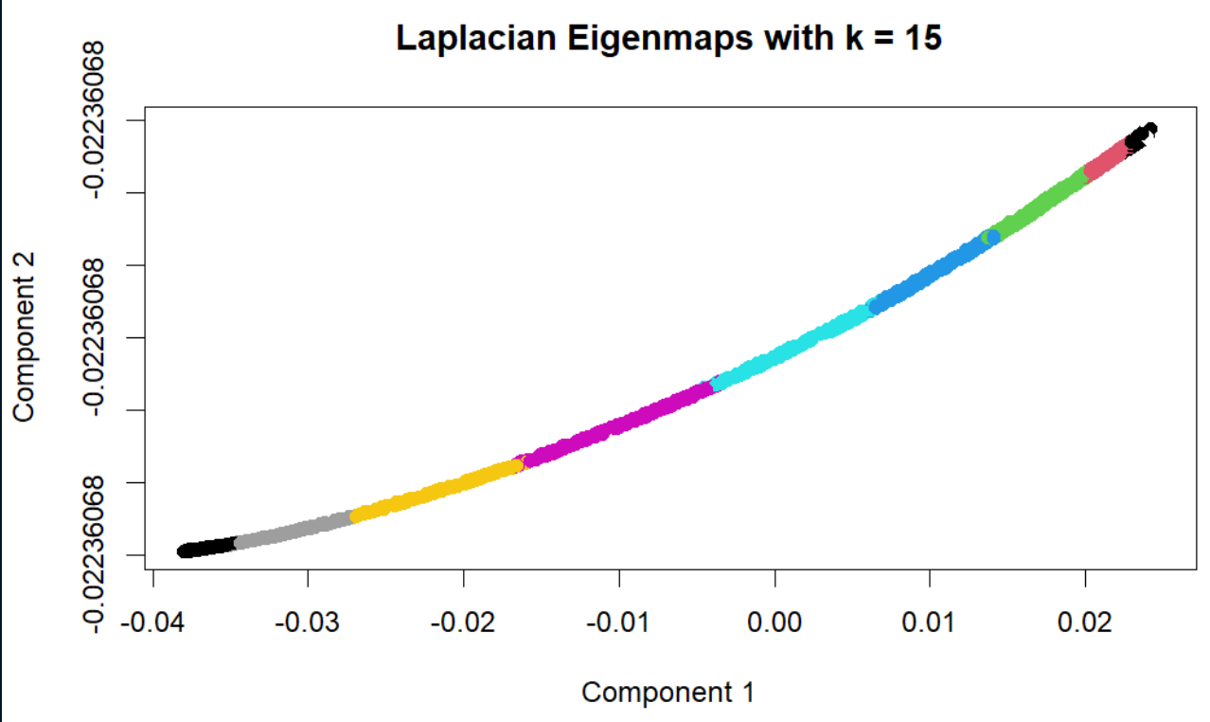
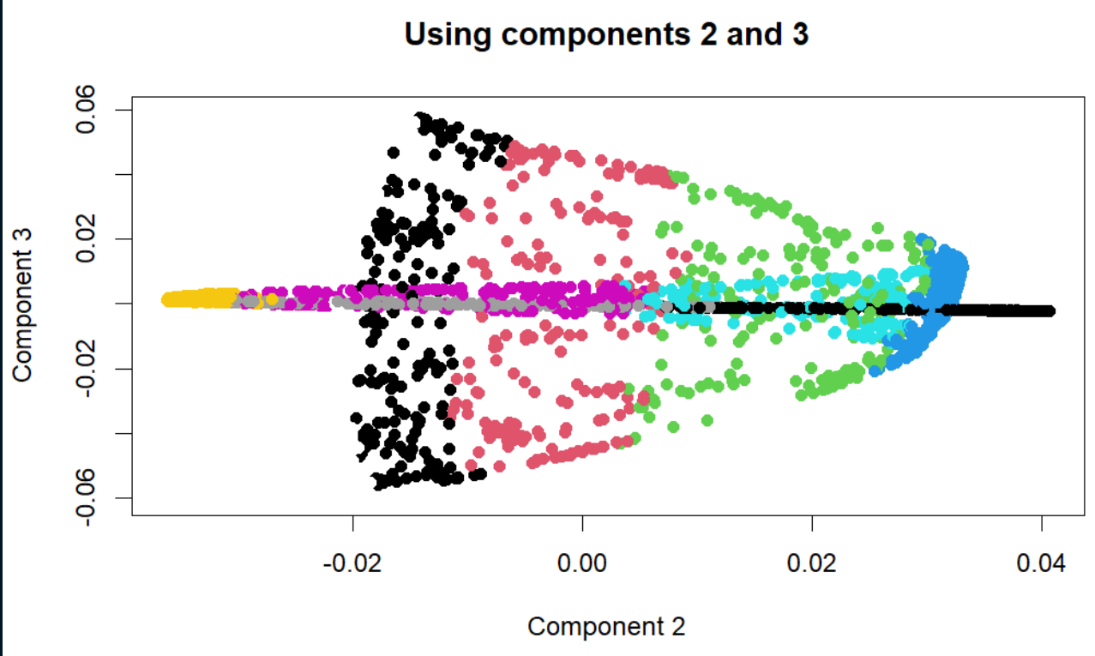
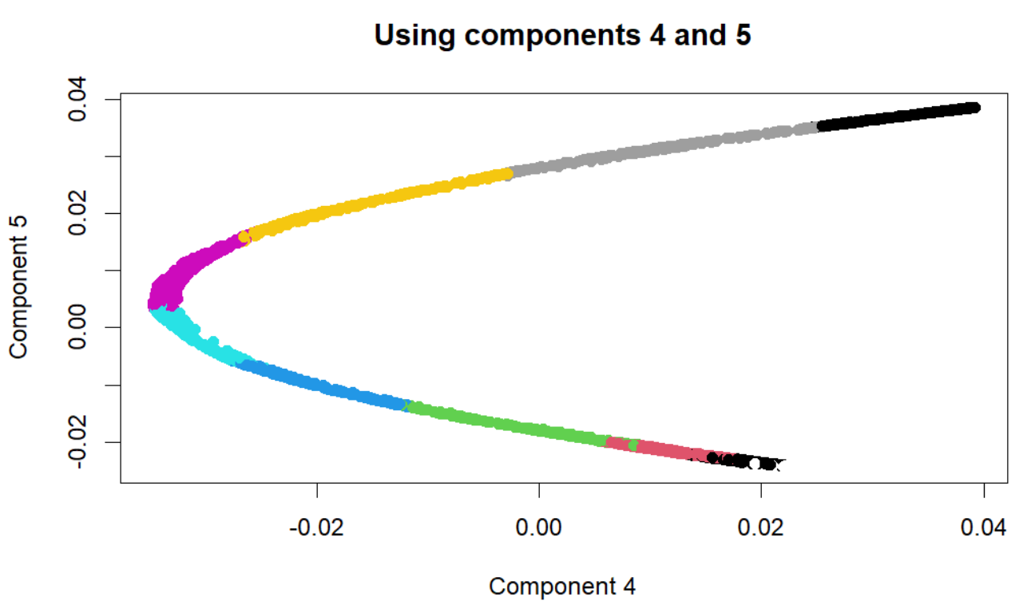
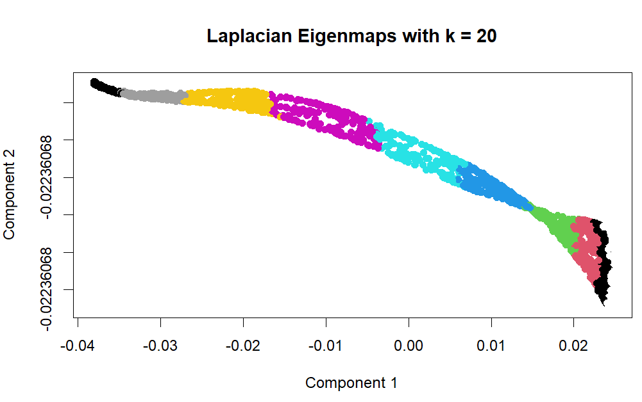
Toy Results

Slide 12
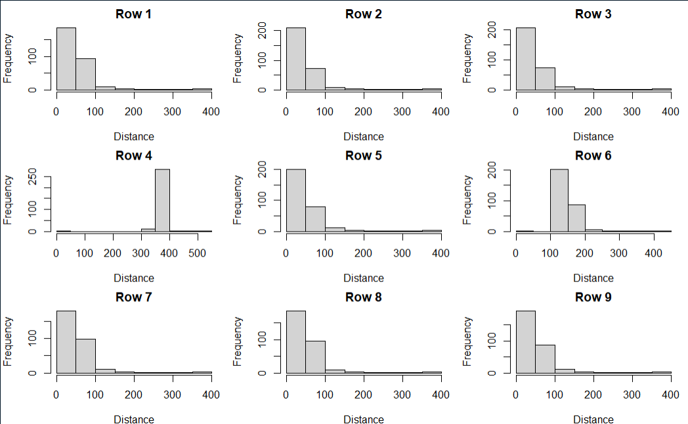
Corpus Distances Matrix Results

Slide 13
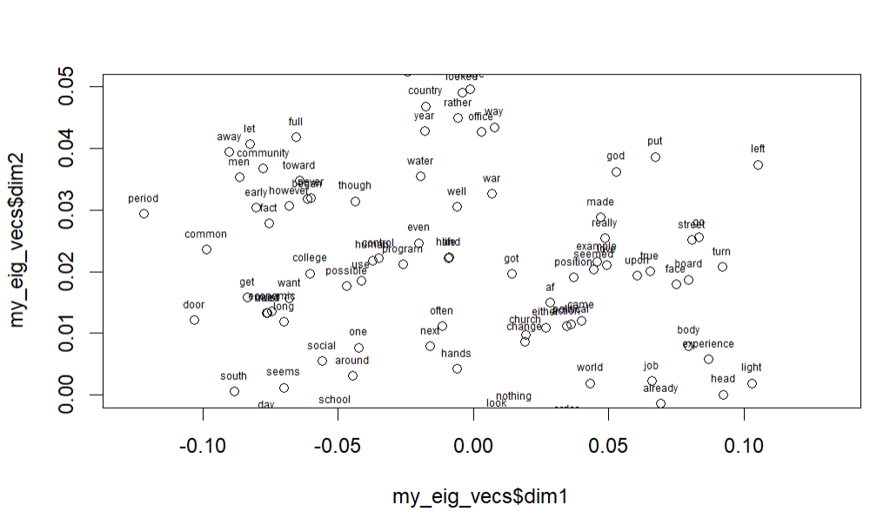
Corpus Results

Slide 14
Plan
1. 對比鄰接圖構建方法（knn/enn），對比不同參數（k/e），對比採用不同特征向量（12，23，34，45……），對比其它降維方法（PCA？MDS？）
2. 將laplacian eigen map方法應用到Corpus和Toy兩個資料集中。
3. 閱讀文章"Kernelized Supervised Laplacian Eigenmap for Visualization and Classification of Multi-Label Data", 嘗試將Lap方法應用到圖像的分類中，研究有監督的Lap方法。

